Slide 1


DAYANANDA SAGAR COLLEGE OF ENGINEERING
INFORMATION SCIENCE AND ENGINEERING
Forest Fire Detection System
Team:
Ananya M 1DS19IS015
Bhoomika RS 1DS19IS031
Nandini Poddar 1DS19IS063
Neha S Shetty 1DS19IS064
Pankaj Garg 1DS19IS066
Saquib Ameer Khan 1DS19IS089
Mentor:
Mr. Rajat Duggal
Nokia University Connect, Bangalore

Slide 2
ABSTRACT
Fire, as one of the world's biggest calamities, must be identified at the right moment before it can do significant damage to the atmosphere and living beings. According to a study, 75-80 percent of the various casualties caused by fire might have been prevented if the misfortune was detected quickly. Particularly in the case of a forest fire, this results in a significant loss to the environment and makes it extremely dangerous for the wildlife habitat. To avoid such losses, an automated system is needed that can provide early detection of any fire situation via any of the alarm systems.
In order to achieve early detection, there are two most used traditional methods of human surveillance.
Human observation
Automation approach
The automated fire alert detection system proposed in this project comprises of three sensors, namely flame, temperature(DHT) and CO2 MQ135. These sensors detect change in a measurable physical quantity and intimate the nearest fire extinguishing station.

Slide 3
CONTENTS
Introduction
Problem Statement
Objective and Scope of the Project.
Block Diagram
Hardware/Software Requirements.
Methodology
Conclusion
References

Slide 4
INTRODUCTION
A wildfire, forest fire, bushfire, wild-land fire or rural fire is an unplanned, uncontrolled fire in an area of combustible vegetation starting in rural and urban areas.
Forest fires not only cause loss of biodiversity, loss of valuable timber, degradation of natural forests and water catchment areas but also result in depletion of carbon sinks, reduction in water table level, global warming, ozone layer depletion and also loss of agricultural production.
So, in order to try and overcome these problems we have proposed an IOT based Forest Fire Detection System.
The Forest fire detection system uses advanced technology which will help in tracing out the forest ﬁre in its initial stage.
The development of IOT based Forest Fire Detection System will be helpful in mapping emergency plans and making them more effective during the occurrence of any disaster.

Slide 5
The aim is to build a Forest fire detection system which would detect the fire using sensors and send an alarm as a safety measure to the living beings around and in the meantime also send an emergency alert to the respective authorities.
The fire IoT aims to link different sensors with Arduino UNO and GSM/GPRS SIM808 module along with buzzer and LEDs.
Here a GSM/GPRS module is used to communicate with IoT servers as well as to intimate the fire extinguishing authority about the occurrence of the fire.
The intensity of the fire will be estimated by using Byram’s formula.
All the data collected is stored and analyzed in the ThingSpeak cloud server.

Slide 6
PROBLEM STATEMENT
Lately the world has seen many occurrences of wildfires which have caused a lot of damage to our biodiversity. These fires have caused damage to wildlife, human life, property and environment. It could be avoided if a robust system could be deployed in forest areas to detect the fire in its initial stage and alert the concerned authority to take an appropriate and immediate action.
Hence our approach addresses the need for an early detection of the forest fire before it spreads to a large scale and causes a number of casualties. As a result of this automated system, a lot of lives as well as the natural resources could be saved. The approach ensures a more reliable and accurate result and is cost effective at the same time.

Slide 7
OBJECTIVE AND SCOPE OF THE PROJECT
The main objective of this proposed model is to predict the developing trend of the fire by building a Forest fire detection system using IoT which would detect the fire and send an emergency fire alert to Authority.
The scope of the proposed model is to detect a fire quickly and provide an early warning notification to the respective authority and also alert the surrounding ecosystem with a fire alarm.

Slide 8
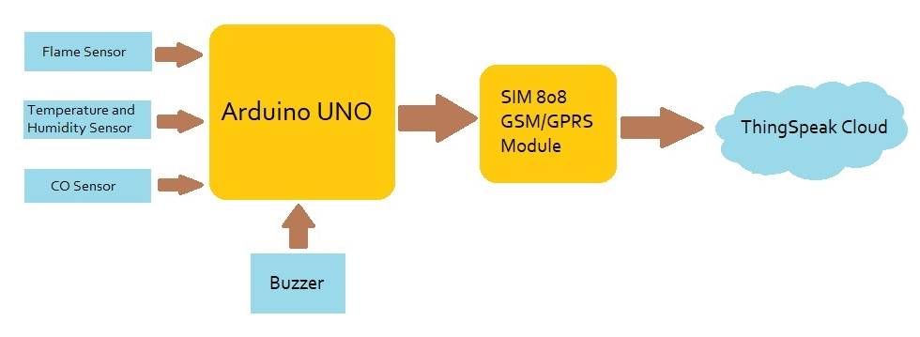
BLOCK DIAGRAM

Slide 9
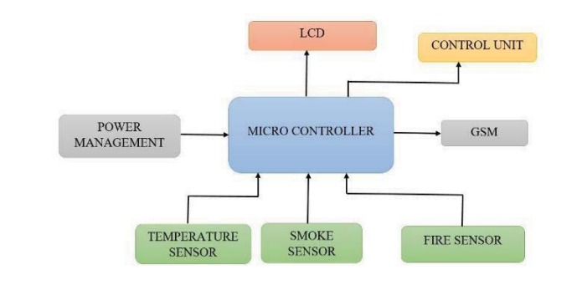
HARDWARE REQUIREMENTS
Arduino UNO
SIM808 GPS/GPRS Module
Sensors-
Flame
DHT
CO2 MQ1325
Buzzer, LEDs
3.7V Li-ion Battery
Dot matrix Perf board
5 V power supply
Jumper wires and cables
Resistors
SOFTWARE REQUIREMENTS
Arduino IDE (1.8.13)
ThingSpeak Account (Cloud)

Slide 10
METHODOLOGY
Connect the Flame sensor, DHT sensor and the CO2 MQ135 sensor to the microcontroller (Arduino UNO).
Also connect SIM808 module via Logic shifting resistors.
Connect the buzzer and LEDs for the alarming system.
Supply power to SIM808 module.
5V DC external supply is given to Arduino UNO.
After successful integration of hardware, the Cloud platform needs to be set up, where the real-time data will be received.
Once all the data is received, the intensity of the fire will be estimated and the level of the wild fire will be determined.

Slide 11
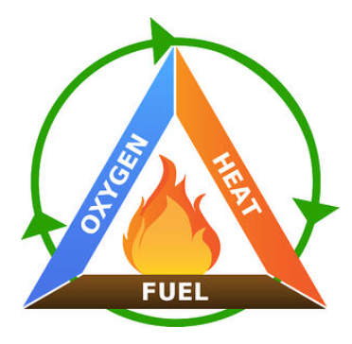
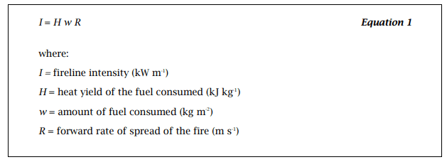
DETERMINING THE FIRE INTENSITY
The extent of a forest fire is classified into 3 stages:
Ignition (Low)
Growth (Medium)
Fully Developed (High)
Byram’s formula:

Slide 12
CONCLUSION
Early cautioning and quick reaction to a fire breakout are the main approaches to dodge incredible misfortunes and natural and social legacy harms. Hence, the most critical objectives in flame observation are fast and solid identification and restriction of the fire. It is substantially less demanding to stifle a fire when the beginning area is known, and keeping in mind that it is in its beginning periods. Data about the advance of flame is likewise profoundly profitable for dealing with the fire amid every one of its stages. In light of this data, the fire battling staff can be guided on focus to hinder the fire before it achieves social legacy destinations and to smother it rapidly by using the required putting out fires hardware and vehicles.
APPLICATIONS
1. Forest fire applications.
2. In industries for fire surveillance.
3. Big society for fire alert.

Slide 13
REFERENCE
IEEE-
https://ieeexplore.ieee.org/document/8878808
Circuit digest-
https://circuitdigest.com/microcontroller-projects/iot-based-forest-fire-detection-using-arduino-and-gsm-module
IRJET-
https://www.irjet.net/archives/V8/i4/IRJET-V8I4360.pdf
Manx Tech group-
https://www.manxtechgroup.com/forest-fire-detection-using-iot-and-co2-sensors/

